Slide 1








Slide 2


Slide 3
Movie Recommendation
Team :
Dinesh Kruthiventi
Batch -- 156

Slide 4
Agenda
Business Problem and Use case domain understanding(If Required)
Objective of the Project
Web Scraping – Details (Websites, Processor you followed)
Summary of the Data
Exploratory Data Analysis:
Data Cleaning Steps
Data Manipulation Steps
Univariate Analysis Steps
Bivariate Analysis Steps
Key Business Question
Conclusion (Key finding overall)
Q&A Slide
Your Experience/Challenges working on Web Scraping – Data Analysis Project.

Slide 5
**Problem Statement**:
The objective of this project is to explore the Movies dataset and answers some interesting questions like
Which year produced more Movies, profitability analysis, kind of movies are most produced, most produced genres etc.
And Recommending movie based on their requirements

Slide 6
Web Scraping – Details (Websites, Processor)
Websites :- IMDB
We extracted the required information from the IMDB website by using requests and BeautifulSoup libraries.
After getting all my information we converted as a DataFrame by using the Pandas library
After converted to DataFrame we imported that DataFrame to Excel in csv format

Slide 7
Summary of the data
The data consist of 599 rows and 8 columns
The columns are
Title : Name of the Movie
Release_Year : In which year was the movie had released
Genre : Genre of the movie
Duration : The Duration of the movie in Min
Collection : The Gross Collection Of the Movie In Dollars($)
Director : The name Of the Director
Rating : The IMBD Star Rating out of 10
Votes : No: of People likes and voted for a particular movie

Slide 8
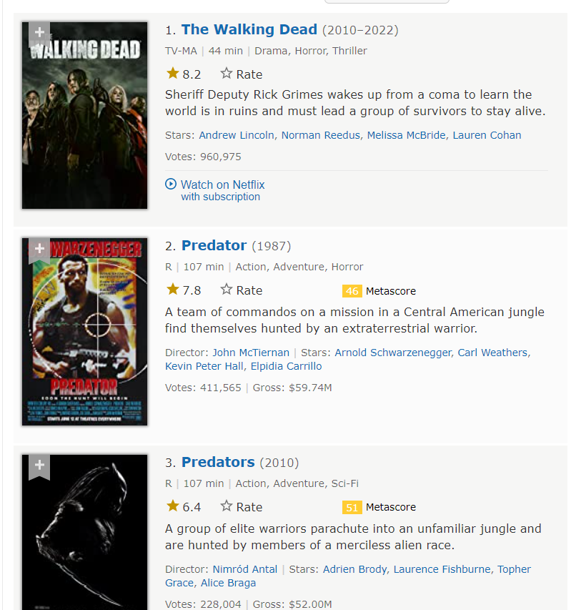
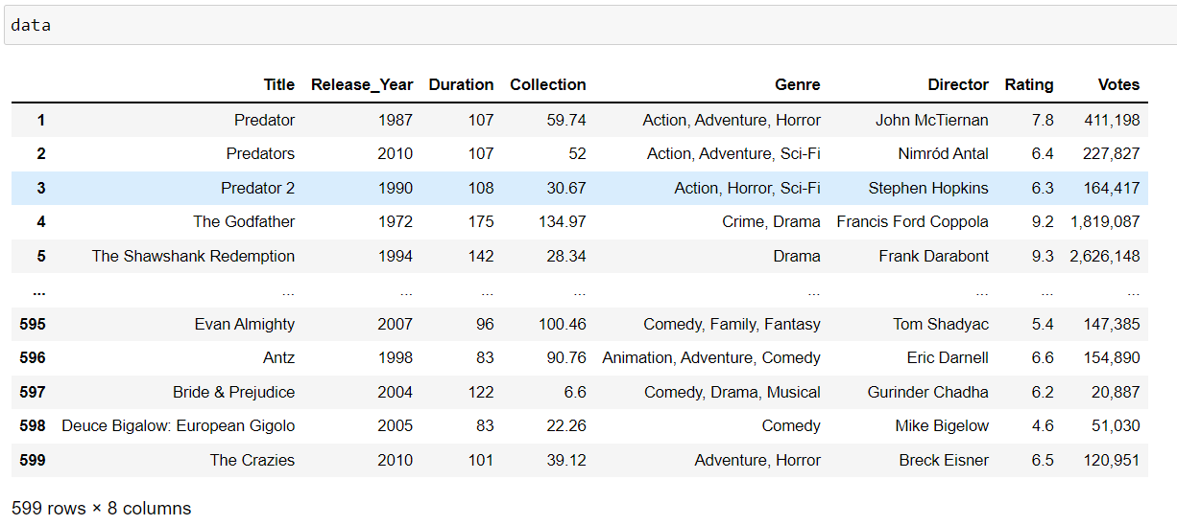
Data Collection
.

Slide 9
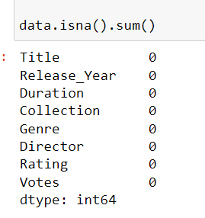
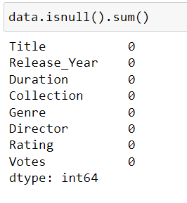
A)-- Data Cleaning
Finding Nan Values
Finding Missing Values

Slide 10
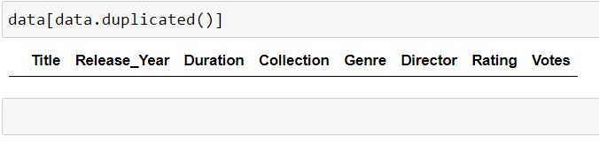
Checking any duplicated values are present
There are no duplicate values present in the data

Slide 11
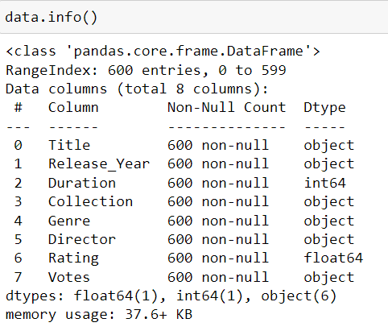
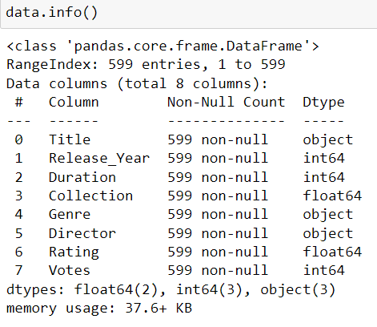
B)– Data Manipulating
Changing the data types

Slide 12
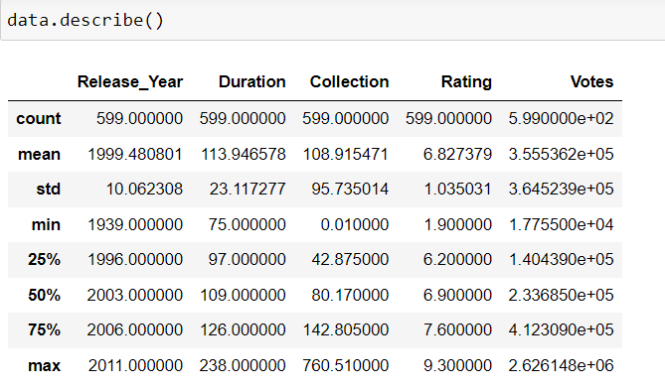
Statistical over view of the data

Slide 13


Slide 14
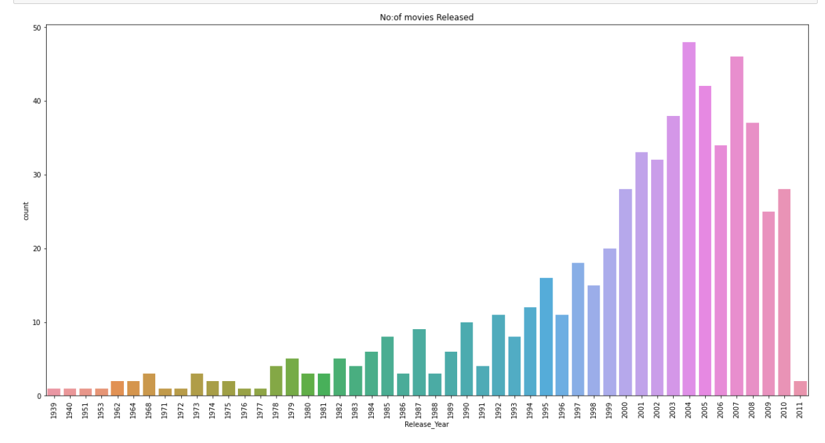
Counting the Releasing Years
By the graph we can see that there will be more films on 2004 is nearly 48
Max → 48
Min → 1

Slide 15
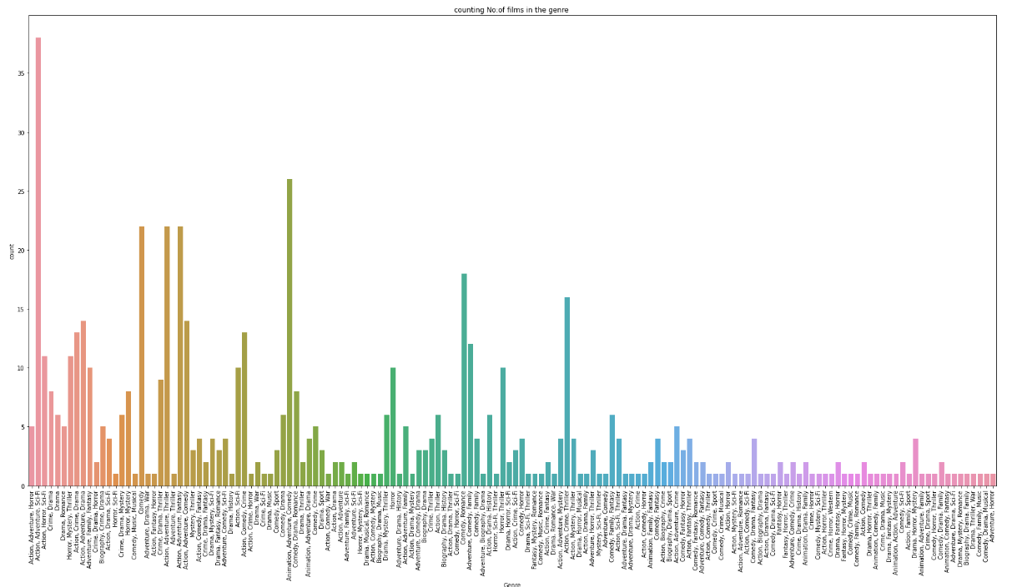
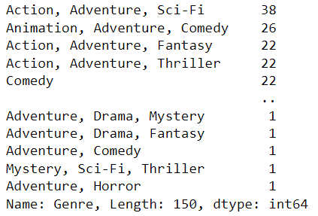
No: of times each Genre is Repeating

Slide 16
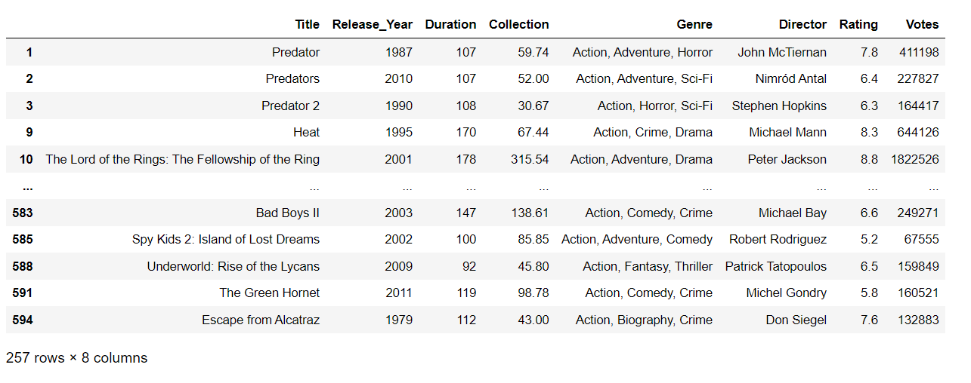
No: of Action movie in the Data
There are 257 Action movies are present in the data

Slide 17
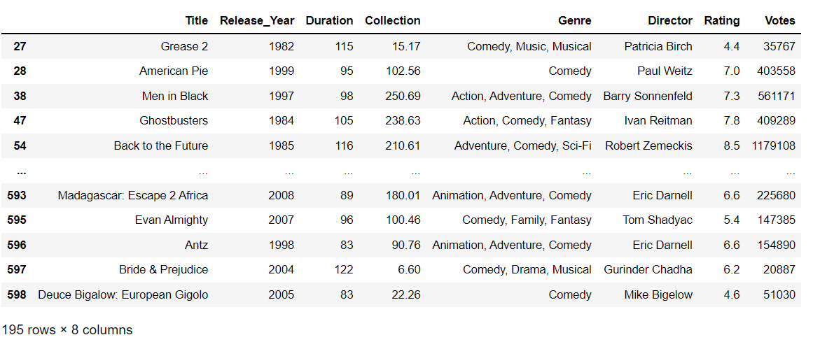
No : of Comedy Movies Present in the Data
There are 195 Comedy movies are present in the data

Slide 18
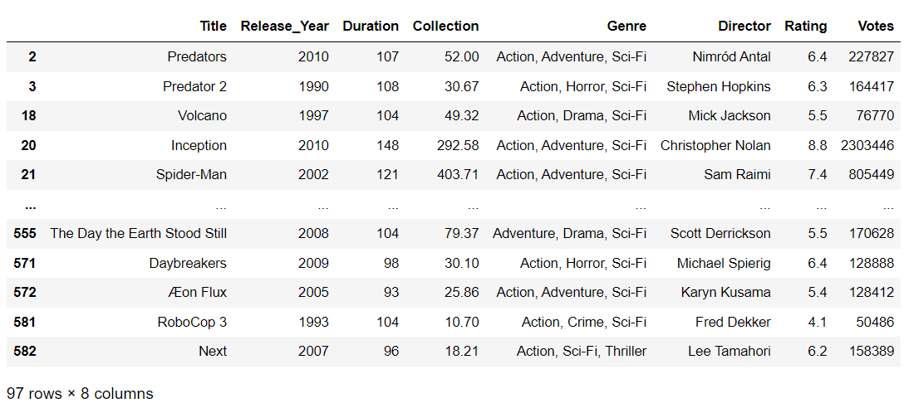
No : of Sci-Fi Movies are present in the data
There are 97 Sci-Fi movies present in the data

Slide 19
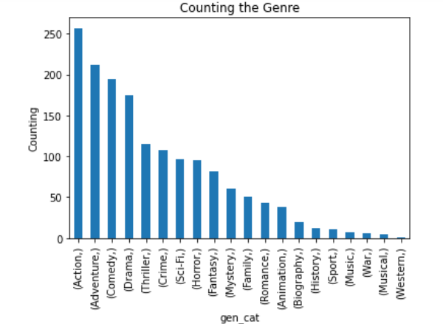
How many times that each genre had occurred
Here we can see that there are more movies on Action Genre
Max → Action
Min → Western

Slide 20
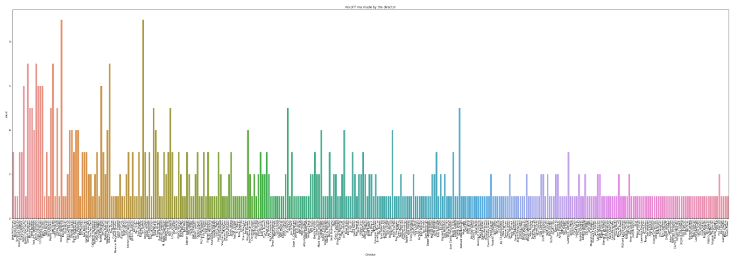
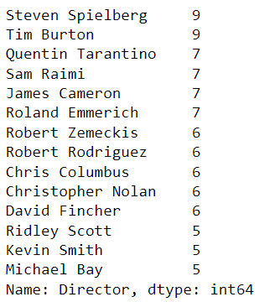
No : of movies made by the each director
Steven Spielberg is the top director directed many movies according to the data
Max → Steven Spielberg ( 9 )
Min → Breck Eisner (1)

Slide 21
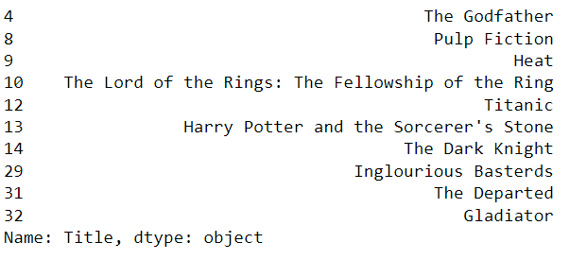
The Top 10 movies which are more than 150 min

Slide 22
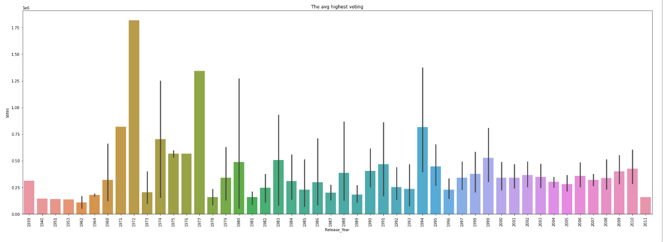
In which year the highest voting
Max → 1972
Min → 1962
The graph shows that the Max and Min values for the Voting

Slide 23
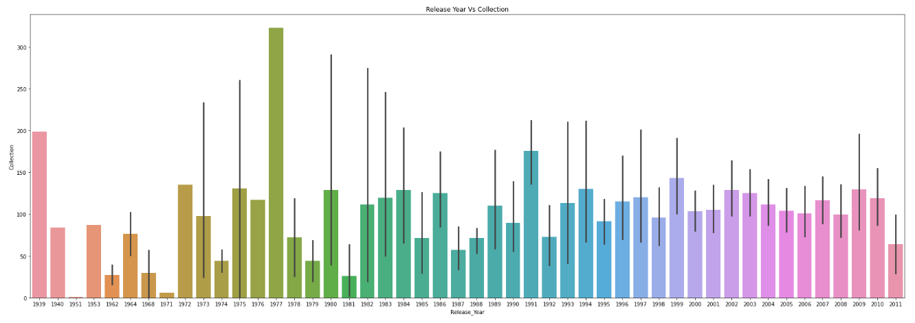
Year wise Highest Average Collection
Max Collections in 1977
Min collections in 1971

Slide 24
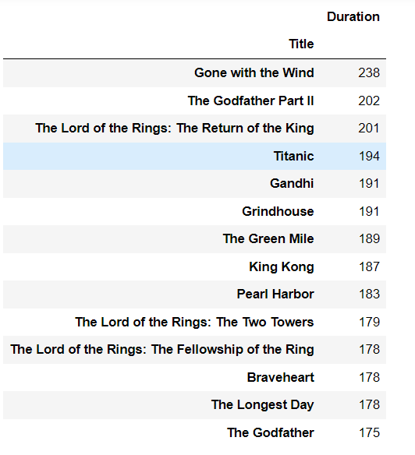
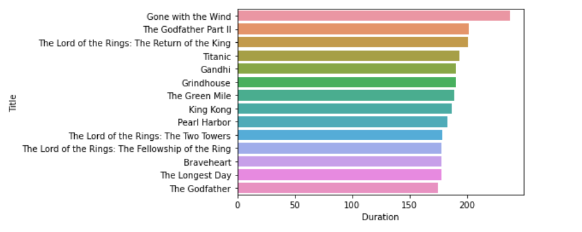
Top 14 lengthy movies

Slide 25
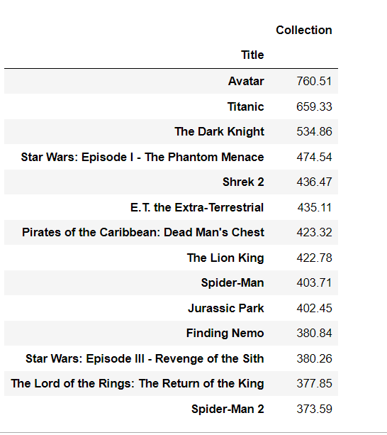
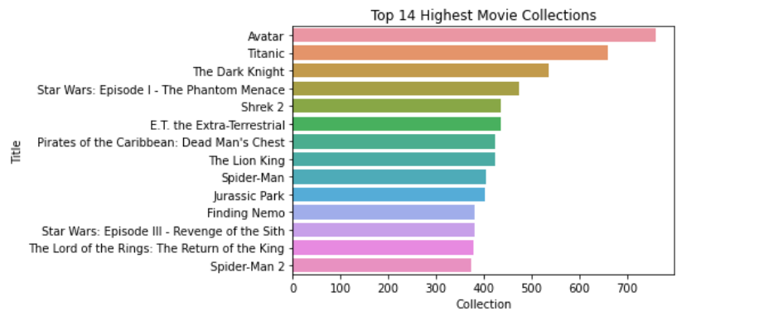
Top 14 highest movie collections

Slide 26
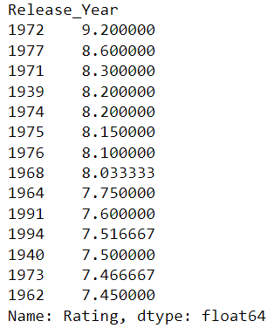
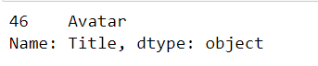
Highest collection for the movie
Average rating for movies Year wise

Slide 27
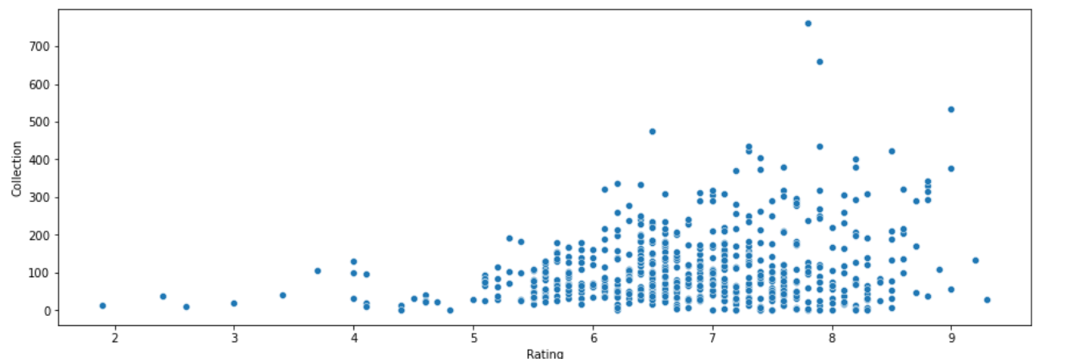
Does Rating Is Effecting Collections
According to the graph when the rating is more than 5.0 then the collection for the movie is also increases

Slide 28
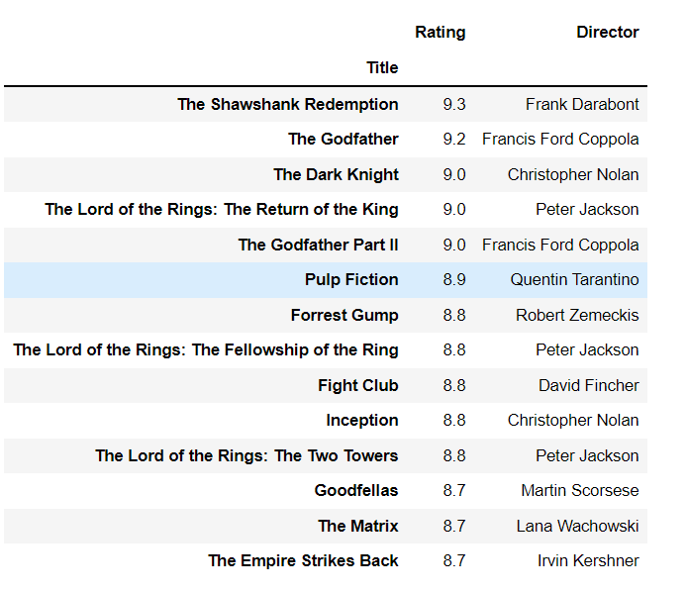
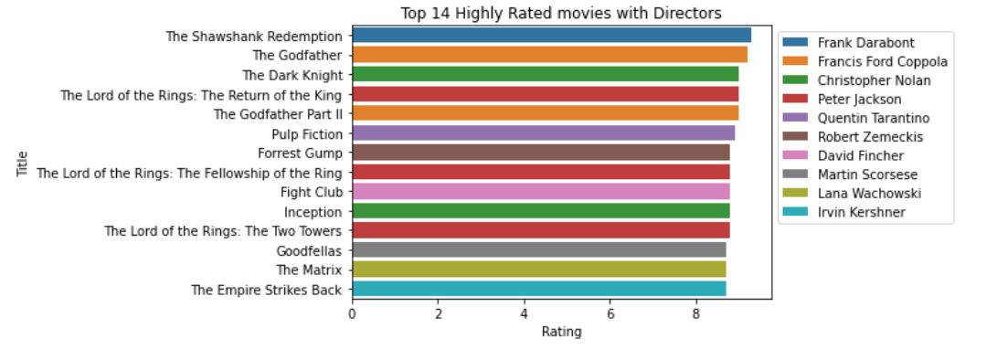
Display top 14 highest rated movies with its directors
The Shawshank Redemption movie has the highest rating with 9.3 and the director is Frank Darabont

Slide 29
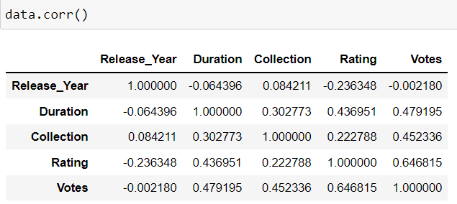
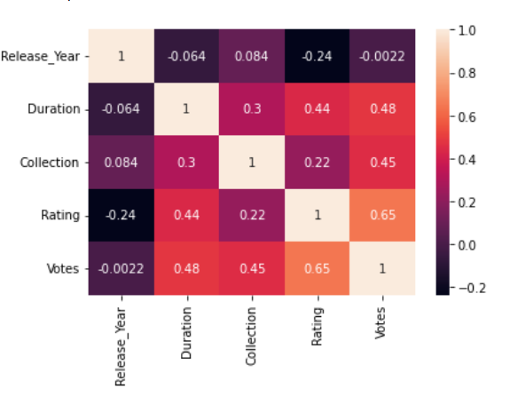
Finding the corelation between complete data
For Finding the correlation of the columns We can observe that there will be no positive correlation as well as a negative correlation. A part from the column is correlating with itself

Slide 30
Scenario - 1
Duration → Greater than 150 min
Rating → Greater than 7.0
Director → should be James Cameron
Genre → Adventure

Slide 31
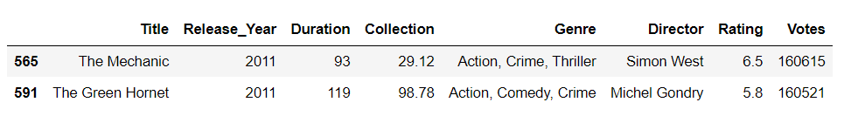
Scenario - 2
Duration → Greater than 60 min
Rating → Greater than 4.0
Release_Year → Must be 2011

Slide 32
Conclusion
After analysing the data we got to know that each and every column plays a major role.
By the analysis we got to know that most films are released in the year 2007.
Most movies that are released are in Genre, Action , Adventure and Sci-Fi.
In the year 1972 movies got highest voting.
1977 is the year when there are highest average movie collections.
Gone with the wind is the movie with highest duration.
Avatar , Titanic , Dark knight and Star Wars are the top 4 highest collected movies of all time.
Shawshank redemption is the high rated movie.
Based on the heatmap we can say that they have no relation between each column.

Slide 33


Slide 34

THANK YOU

